Slide 1
Artificial neural network: multilayer perceptron used as a classifier
(supervised learning)

Slide 2
Feed-forward neural network

Slide 3
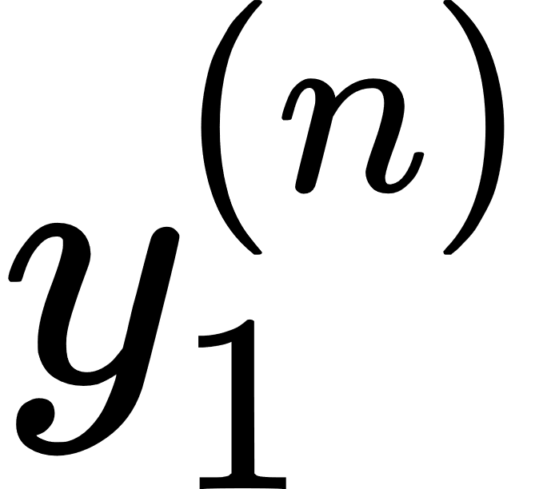
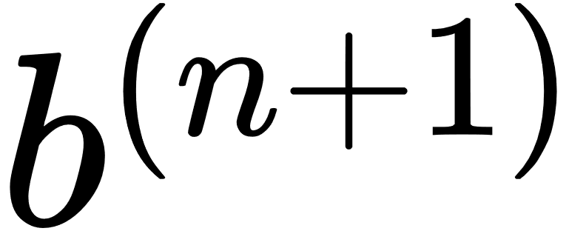
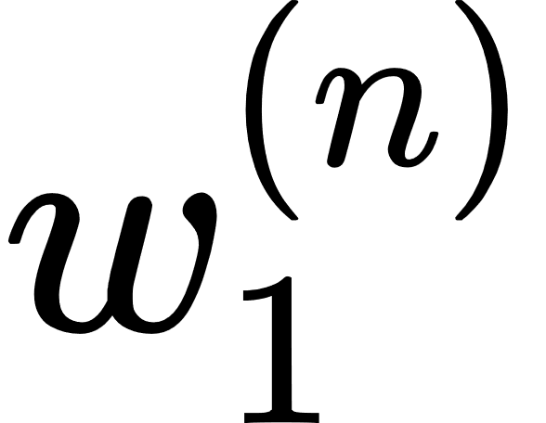
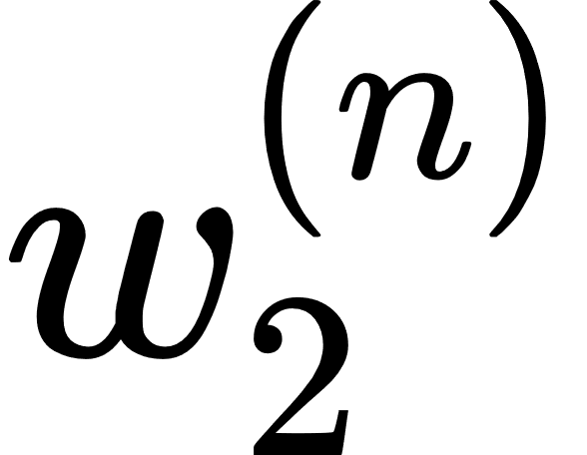
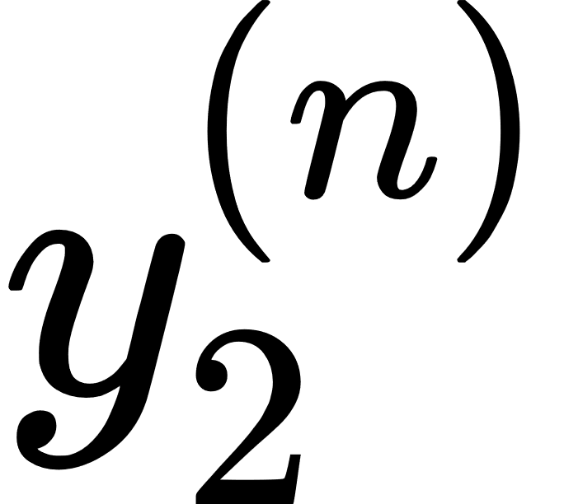

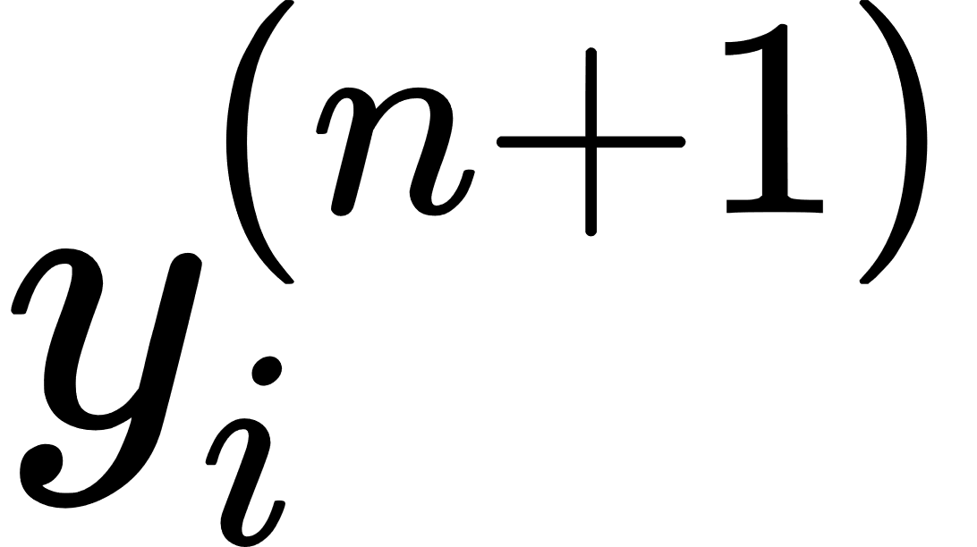
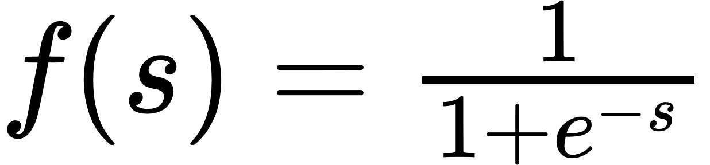
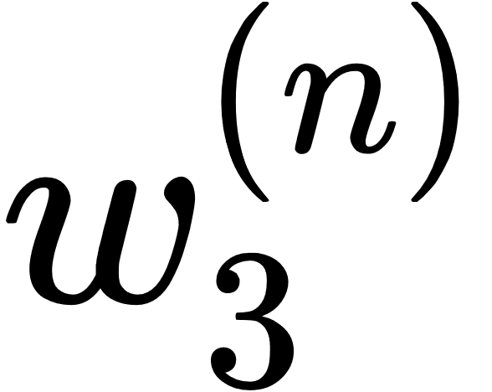
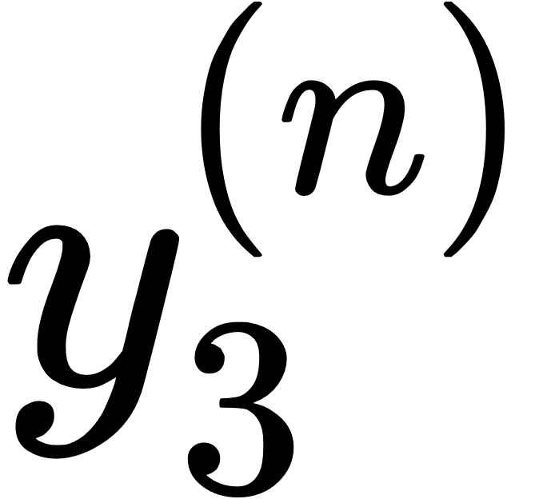
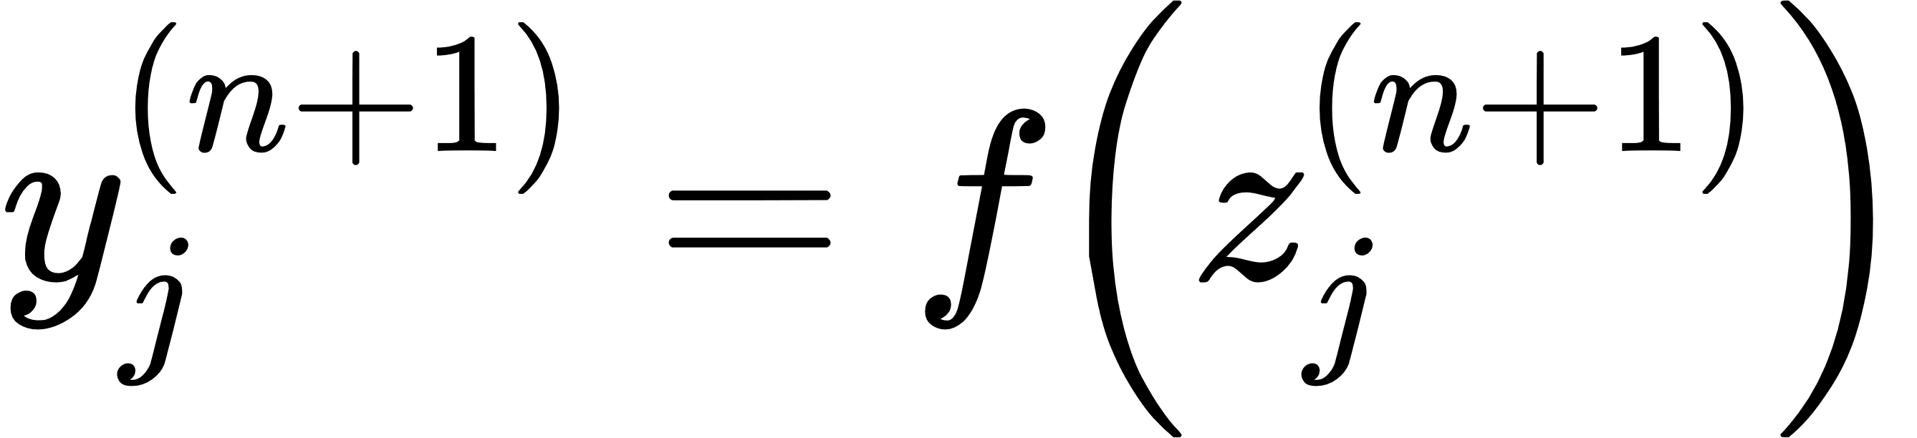
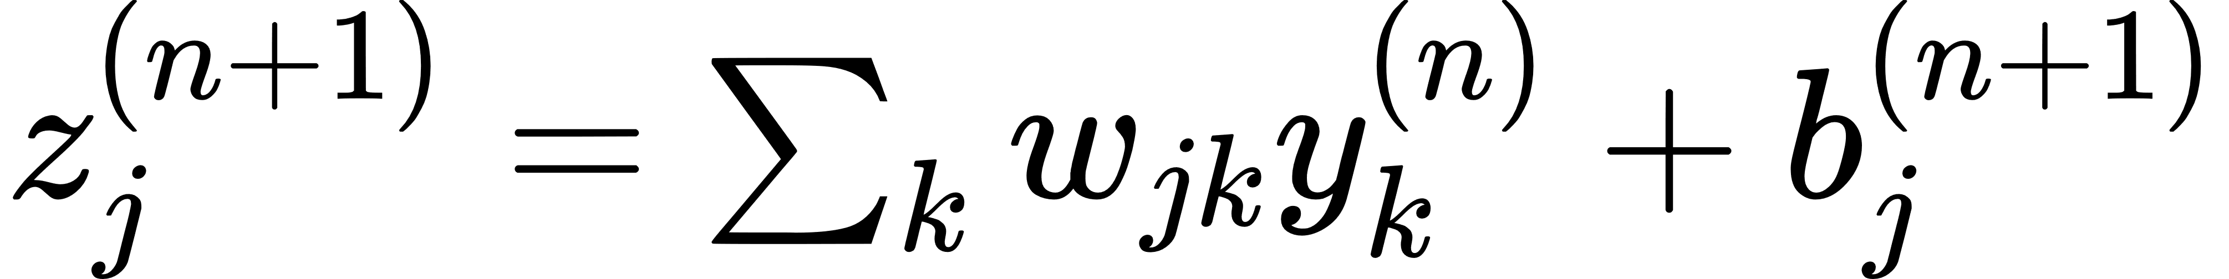
Basic structure
Activation function

Slide 4
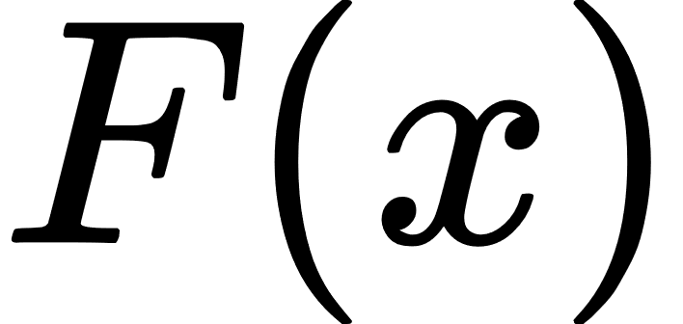
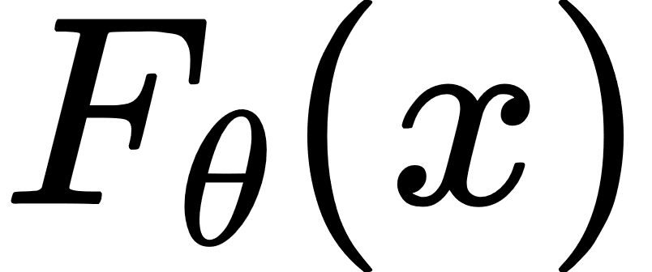
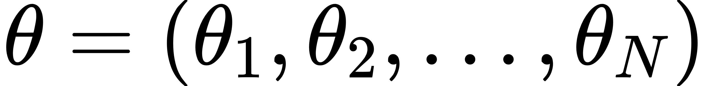
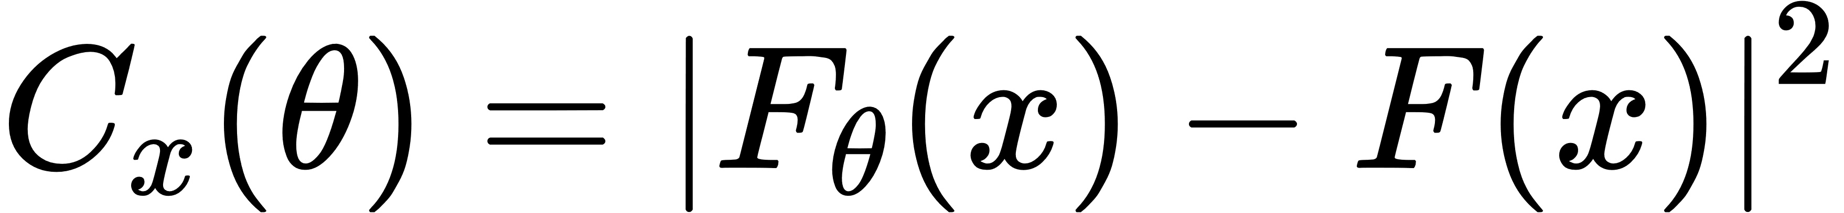
Neural networks as function approximators
ANN can be seen as function approximators
We would like to measure the deviation between the network output and the function it is trying to approximate
SAMPLE-SPECIFIC COST FUNCTION
But depending on your problem there are also other cost functions…

Slide 5
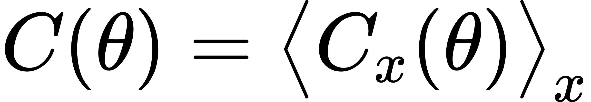
How the ANNs learn
We want to measure and minimize the “distance” between the output of the net and the result we would obtain
supervised learning
During training the sample cost function will be averaged over all sets of training samples
→

Slide 6
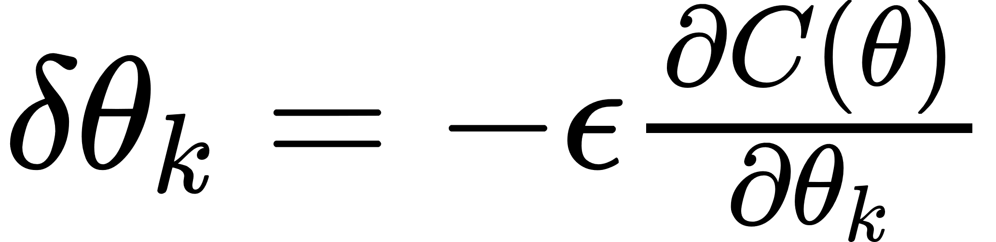
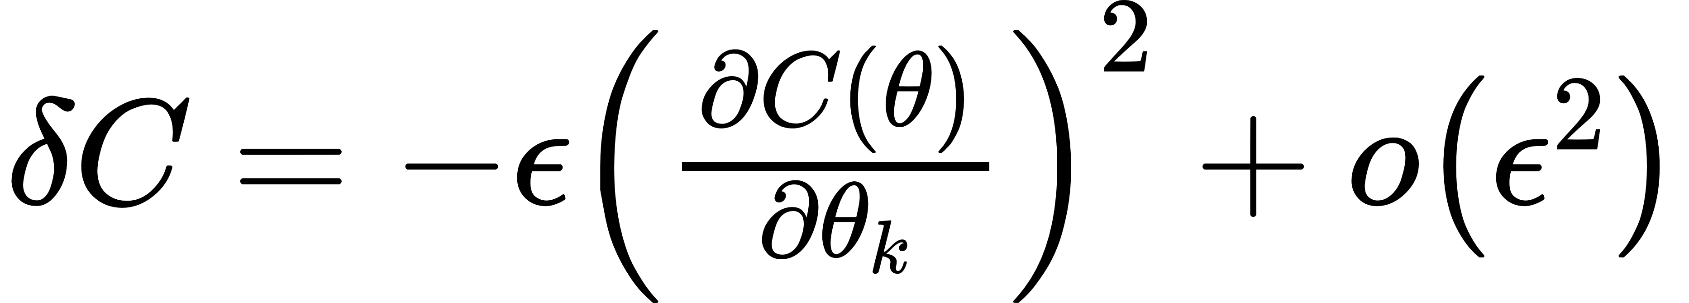
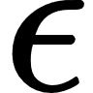
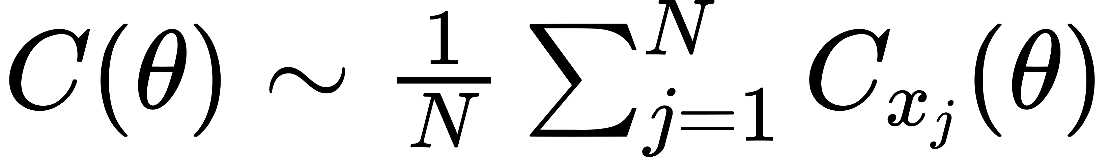
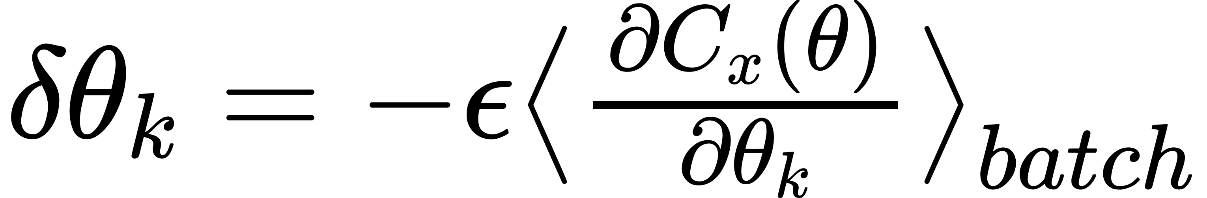
How the ANNs learn: gradient descent
We can update the values of the parameters “sliding down the hill” that means updating parameters by steps
where is what is called learning rate
Since the cost function is defined as the average over ALL possible inputs it can be too expensive to compute
Solution is stochastic gradient descent, or training over batches!

Slide 7
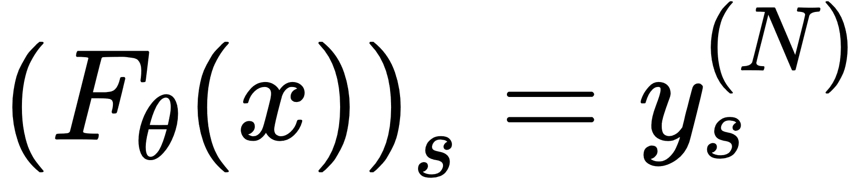
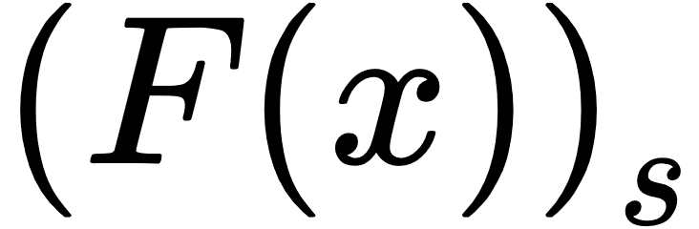
How the ANNs learn: backpropagation
Since numerical differentiation is inefficient due to the large number of parameters we use the chain rule
For the cost function we defined before, we have
where is the value of the s neuron of the output layer N and
the desired output for that neuron

Slide 8
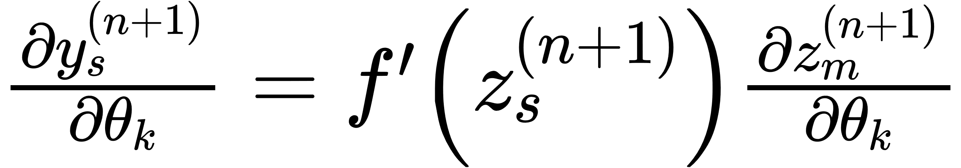
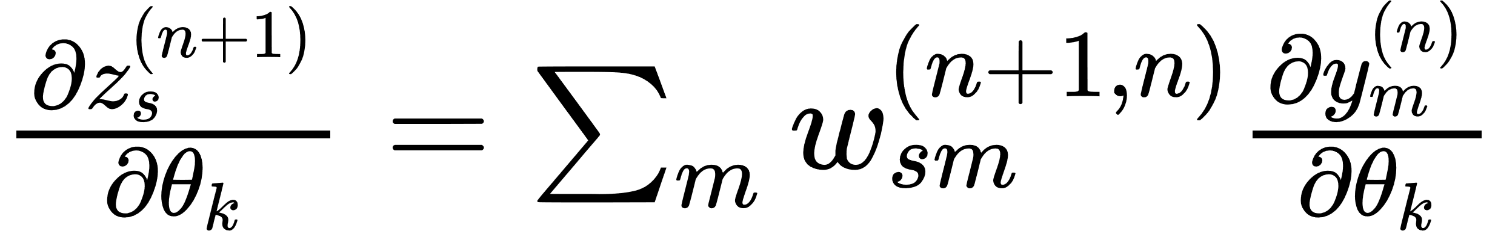
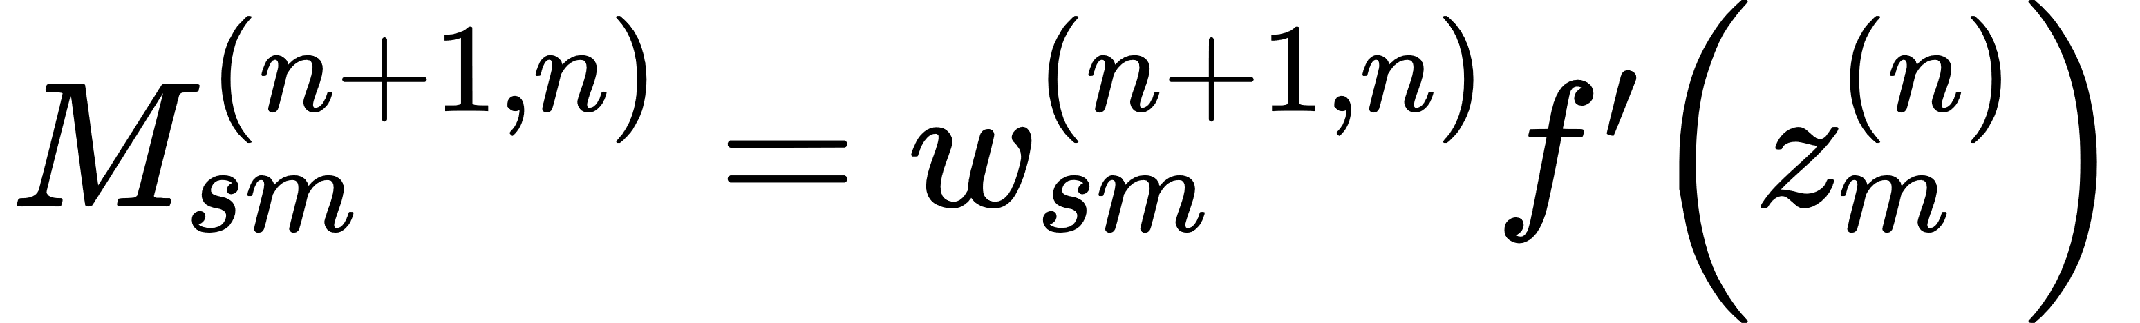
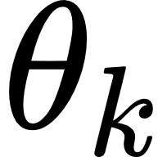
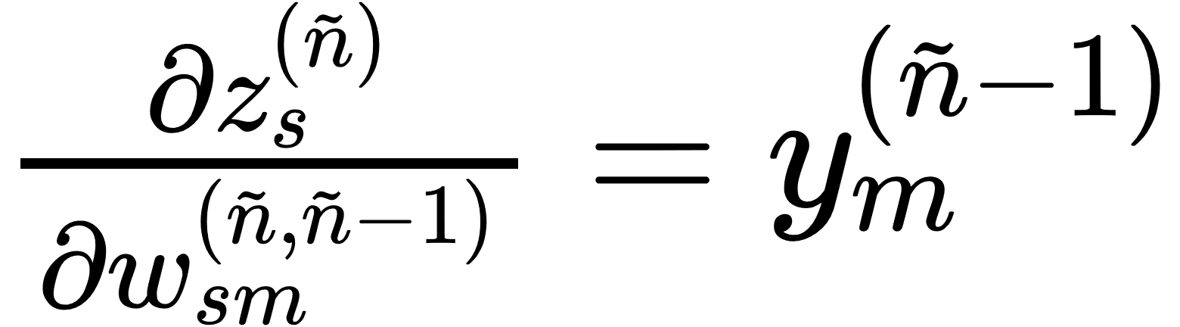
How the ANNs learn: backpropagation
We have now to calculate the gradient of a neuron value with respect to any of the parameters
It is quite evident the recursive structure. By defining the matrix element (in a total general way)
it is possible to show that holds
where ñ is the layer where we want to update the parameter so where .

Slide 9
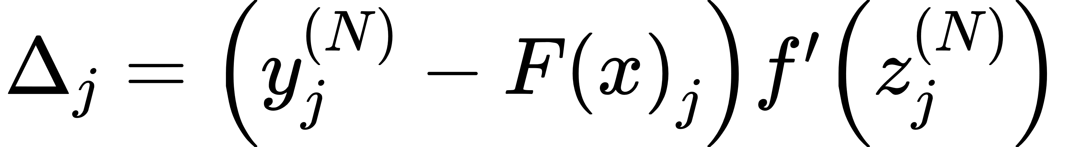
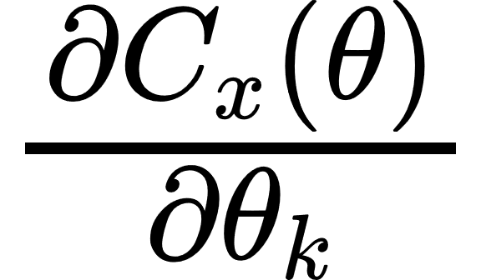
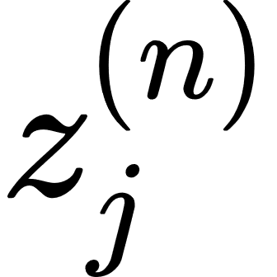
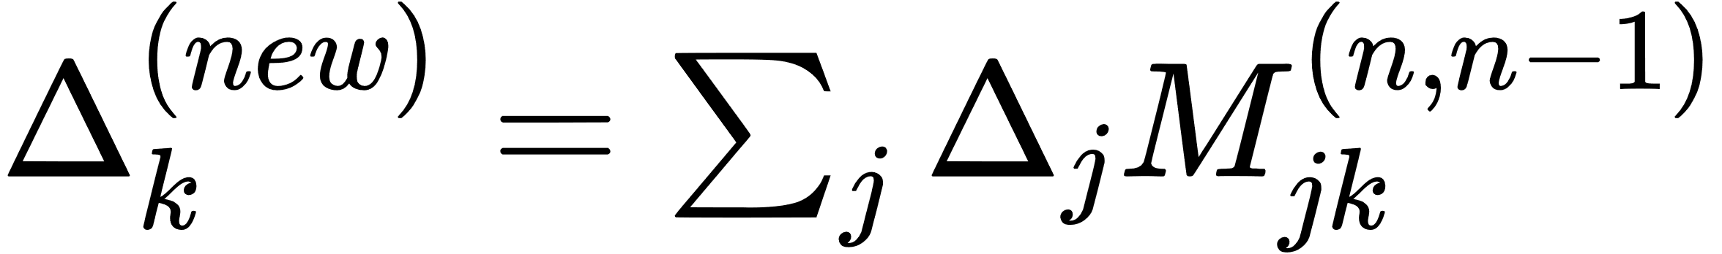
How the ANNs learn: backpropagation
The backpropagation algorithm can be summarized in:
Initialize a “deviation” vector at the output layer N so proportional to the difference between the current j-th output and the expected j-th output
For each layer starting at n=N store the derivative with respect to the parameters at that layer: for all explicitly occurring in
Step down to the next lower layer by setting and repeat after storing derivatives
In this way all the derivatives will be known

Slide 10

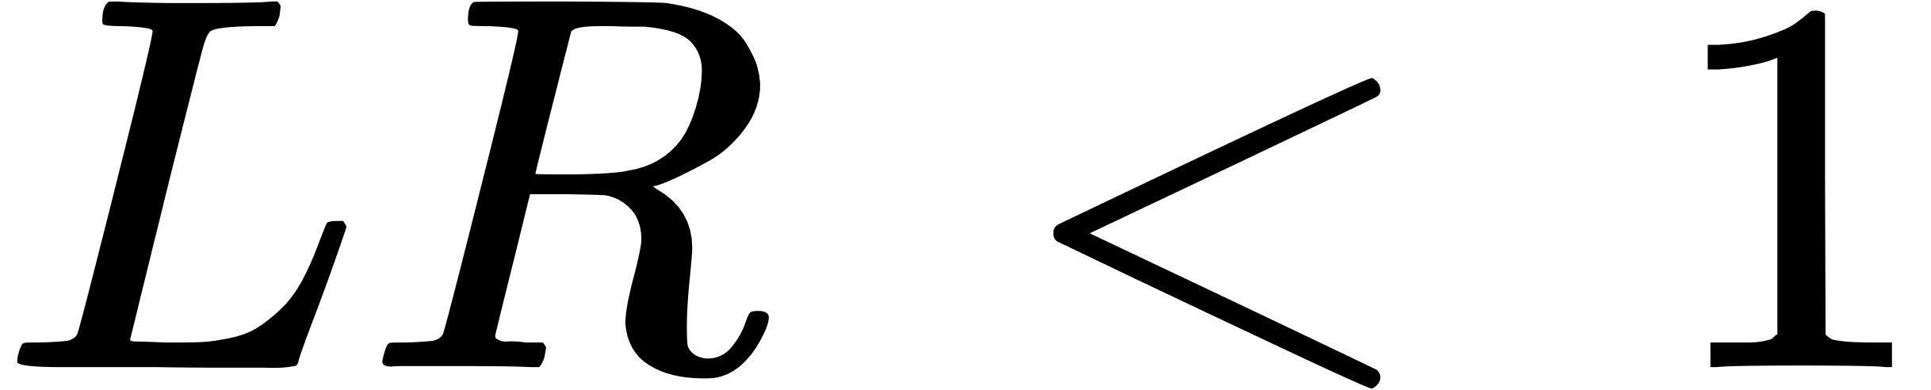
How to choose the learning rate?
The choice of the learning rate depends from the shape of the cost (loss) function. The cost function give us an idea on how the net is actually learning and we have to manually adjust the learning rate to maximize learning.
Usually

Slide 11
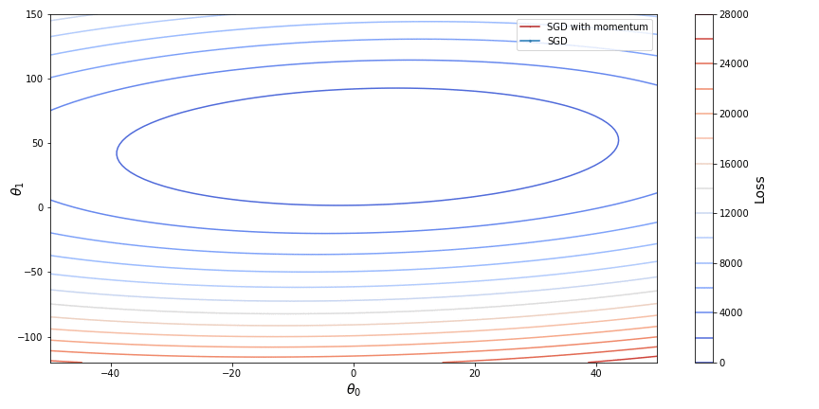
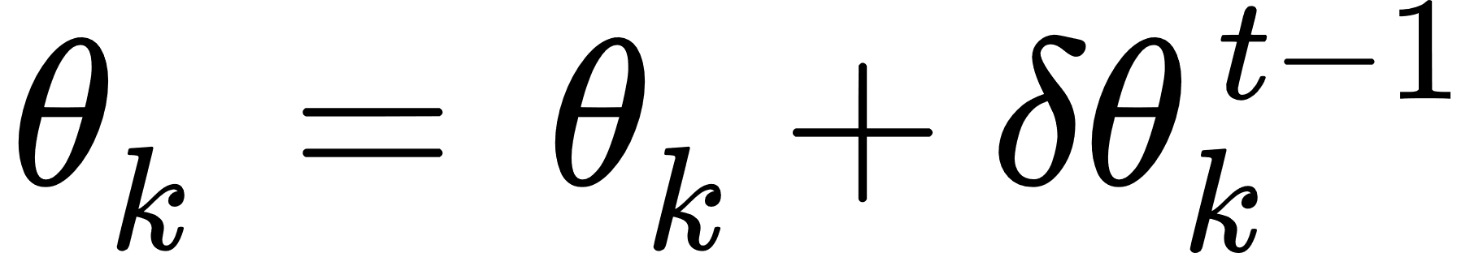
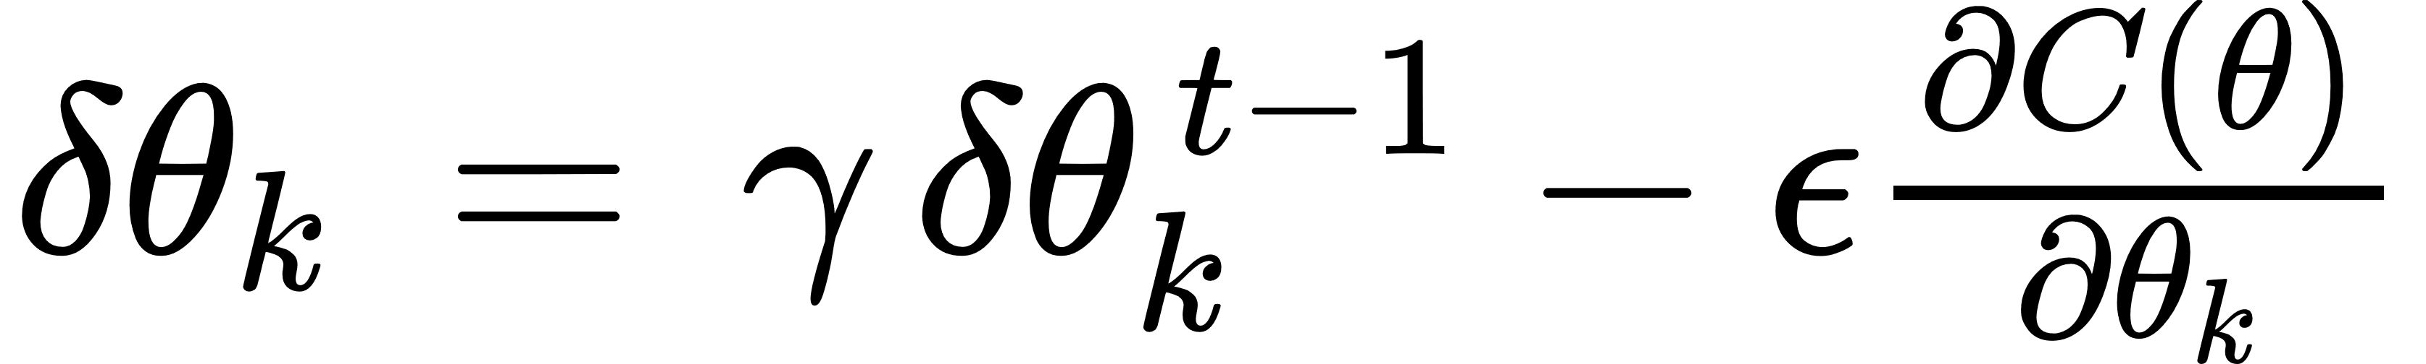
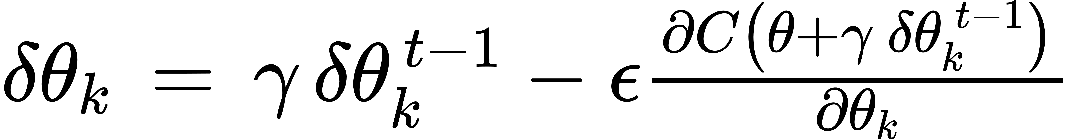
Optimizers - SGD with momentum
Parameter update
SGD with momentum
Nesterov Accelerated Gradient (NAG)

Slide 12

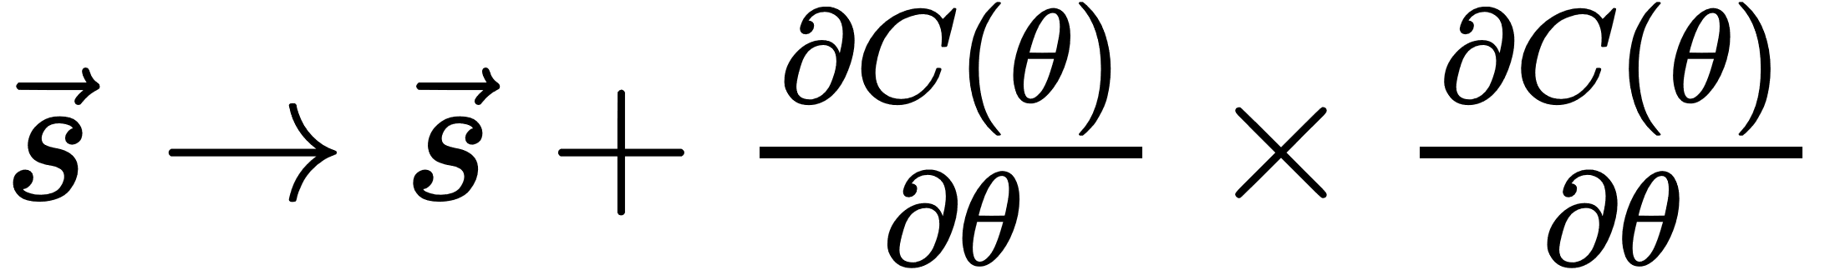
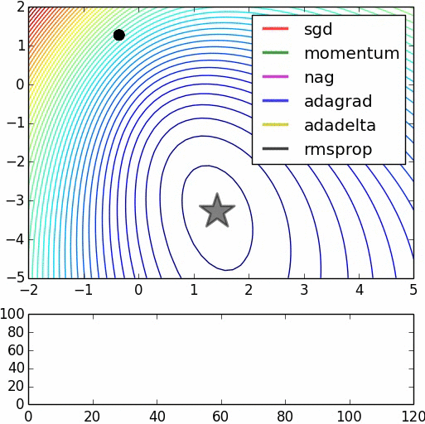
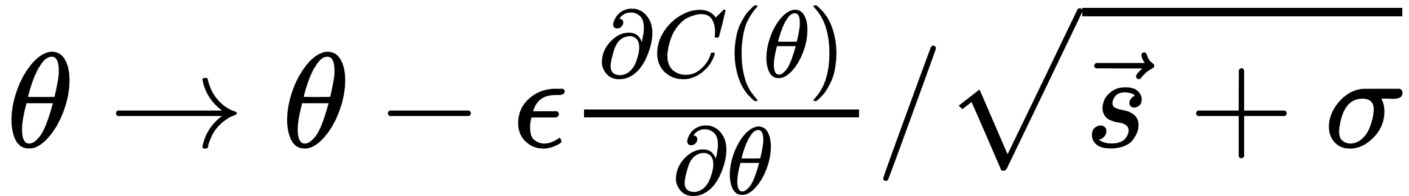
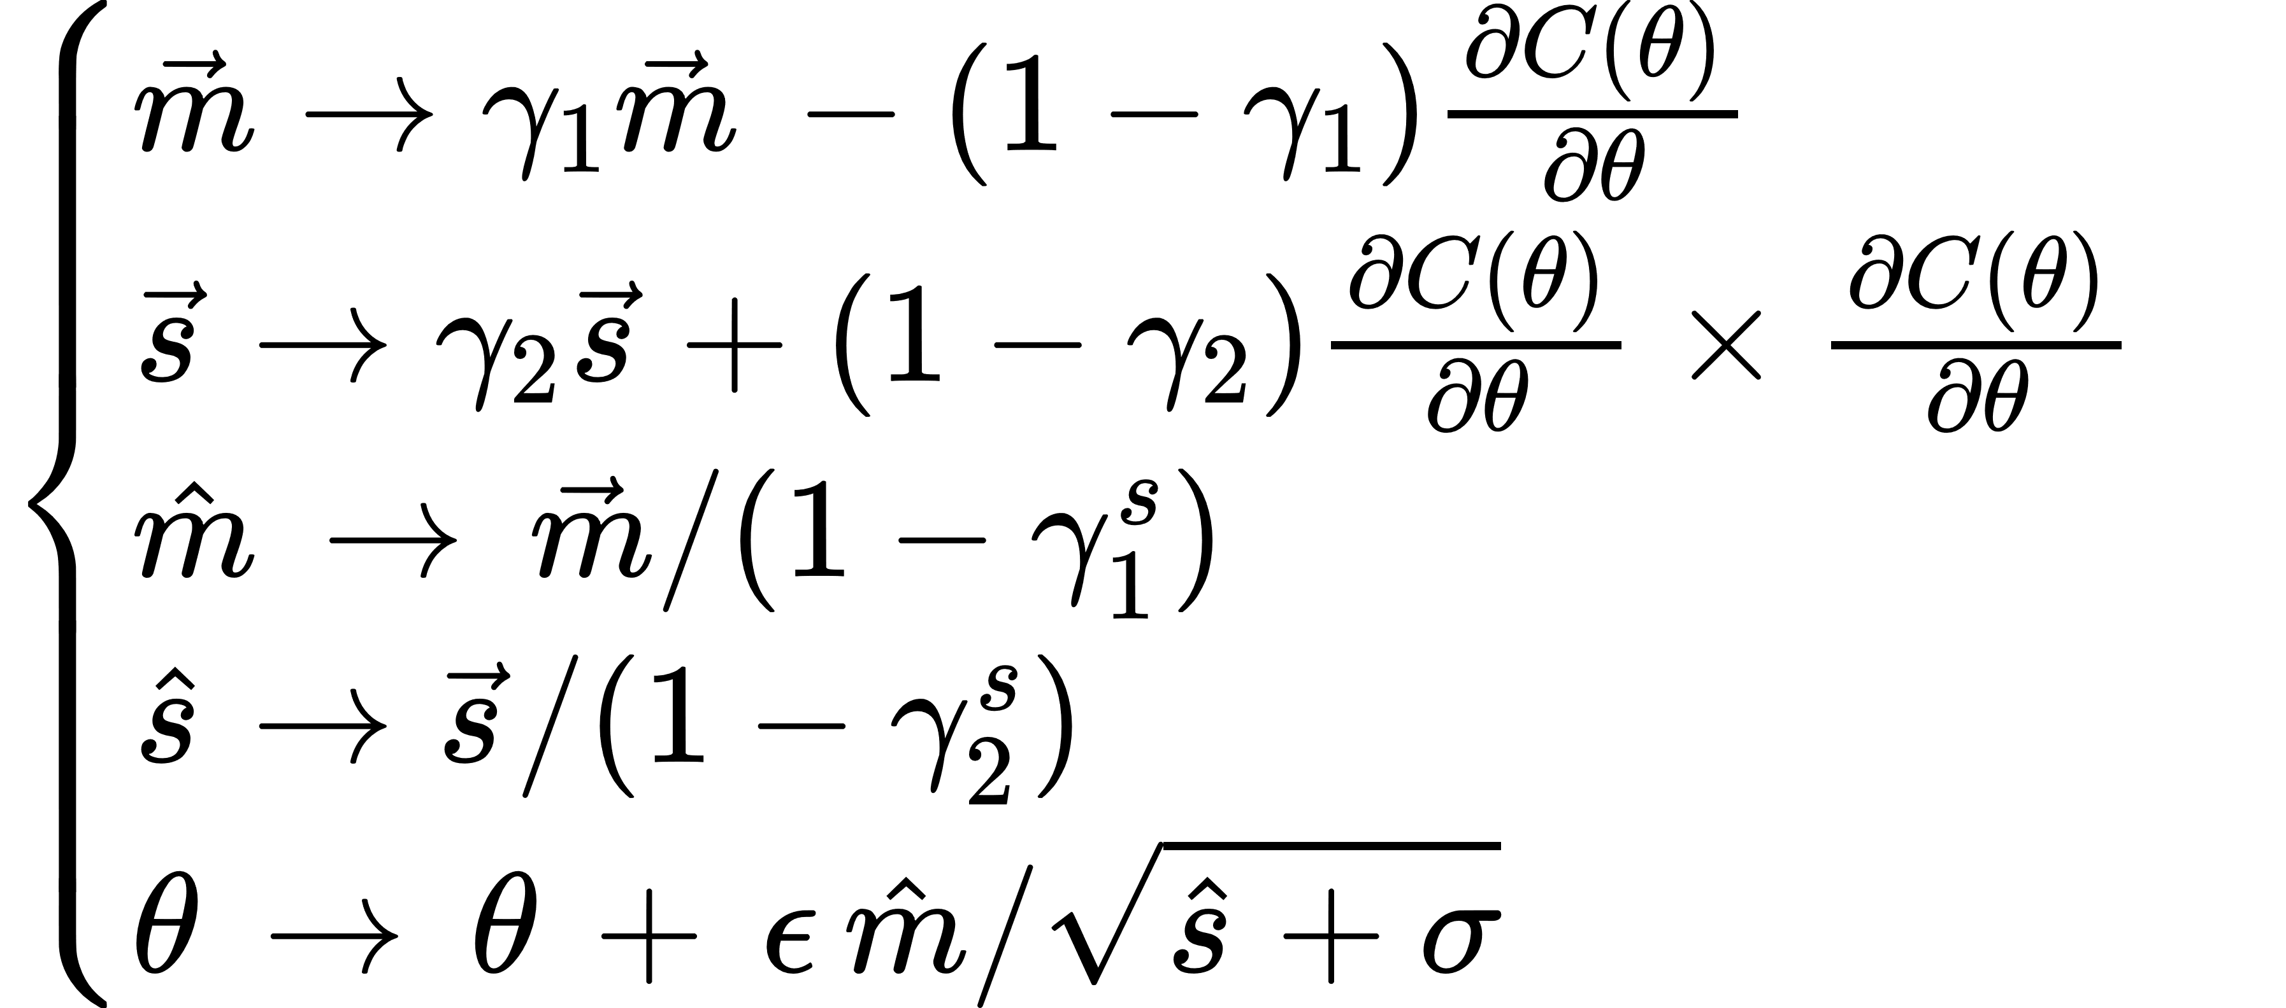
Other optimization algorithms
Adagrad
RMSprop
Adam

Slide 13
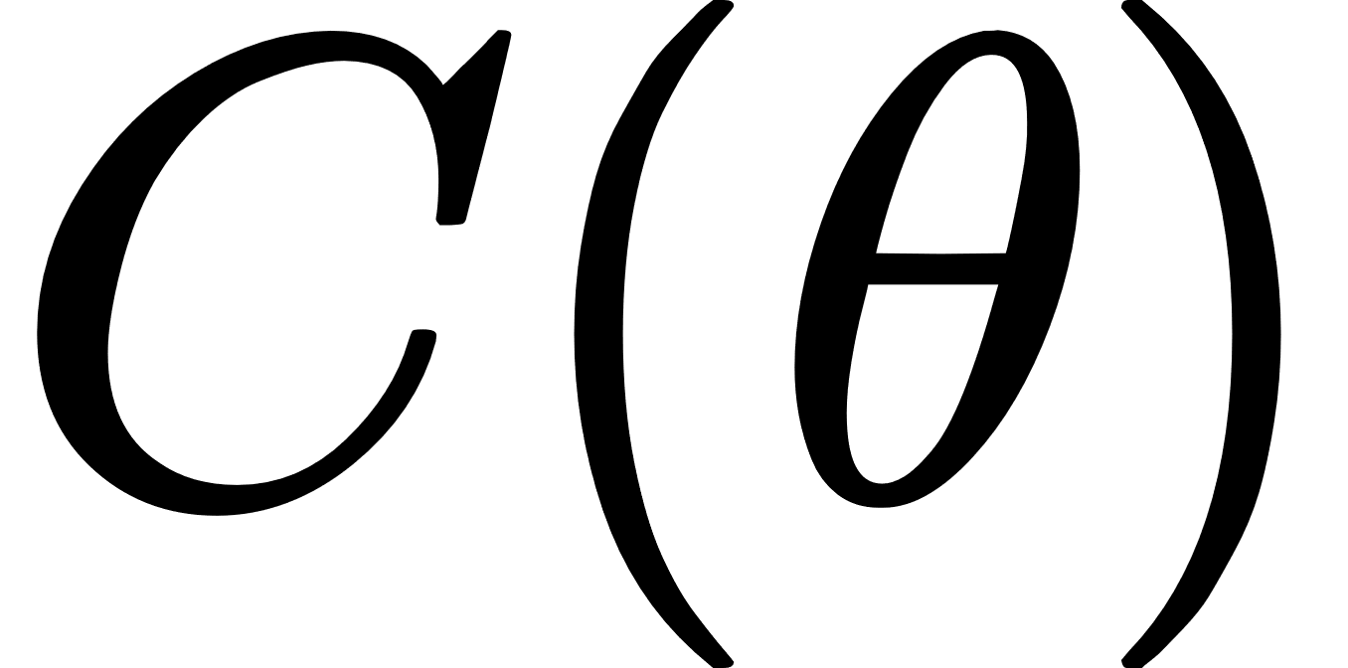
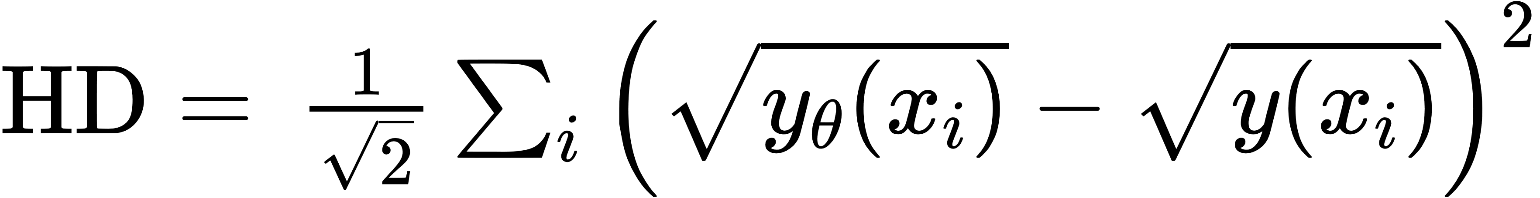
The choice of the
There are several cost function:
Mean Squared Error
Cross Entropy (and Binary)
Kullback–Leibler divergence
Hellinger distance
There is a lot of theory behind cost functions and each one would perform better on a problem with respect to another

Slide 14
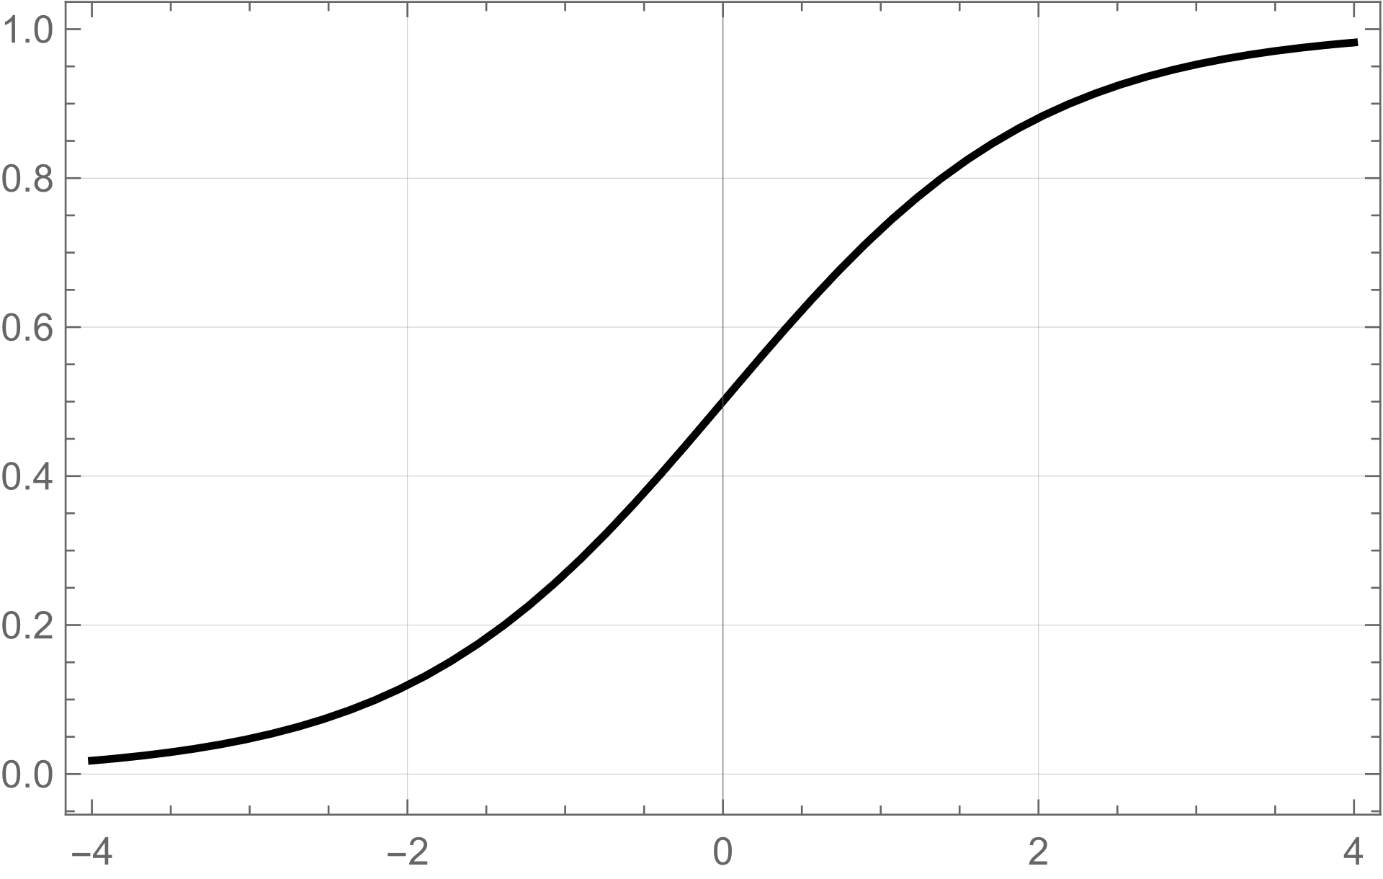
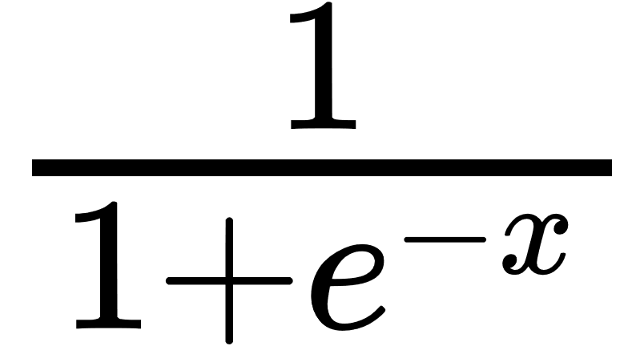
The choice of the activation function
Disadvantages Vanishing gradient - for very high or very low values of the z, there is almost no change to the prediction, causing a vanishing gradient problem. This can result in the network refusing to learn further, or being too slow to reach an accurate prediction. Moreover it is computationally expensive.
Sigmoid
Useful in classification problem together with BCE. Used in the output layer.
Smooth gradient, preventing “jumps” in output values. Output values bound between 0 and 1, normalizing the output of each neuron.

Slide 15
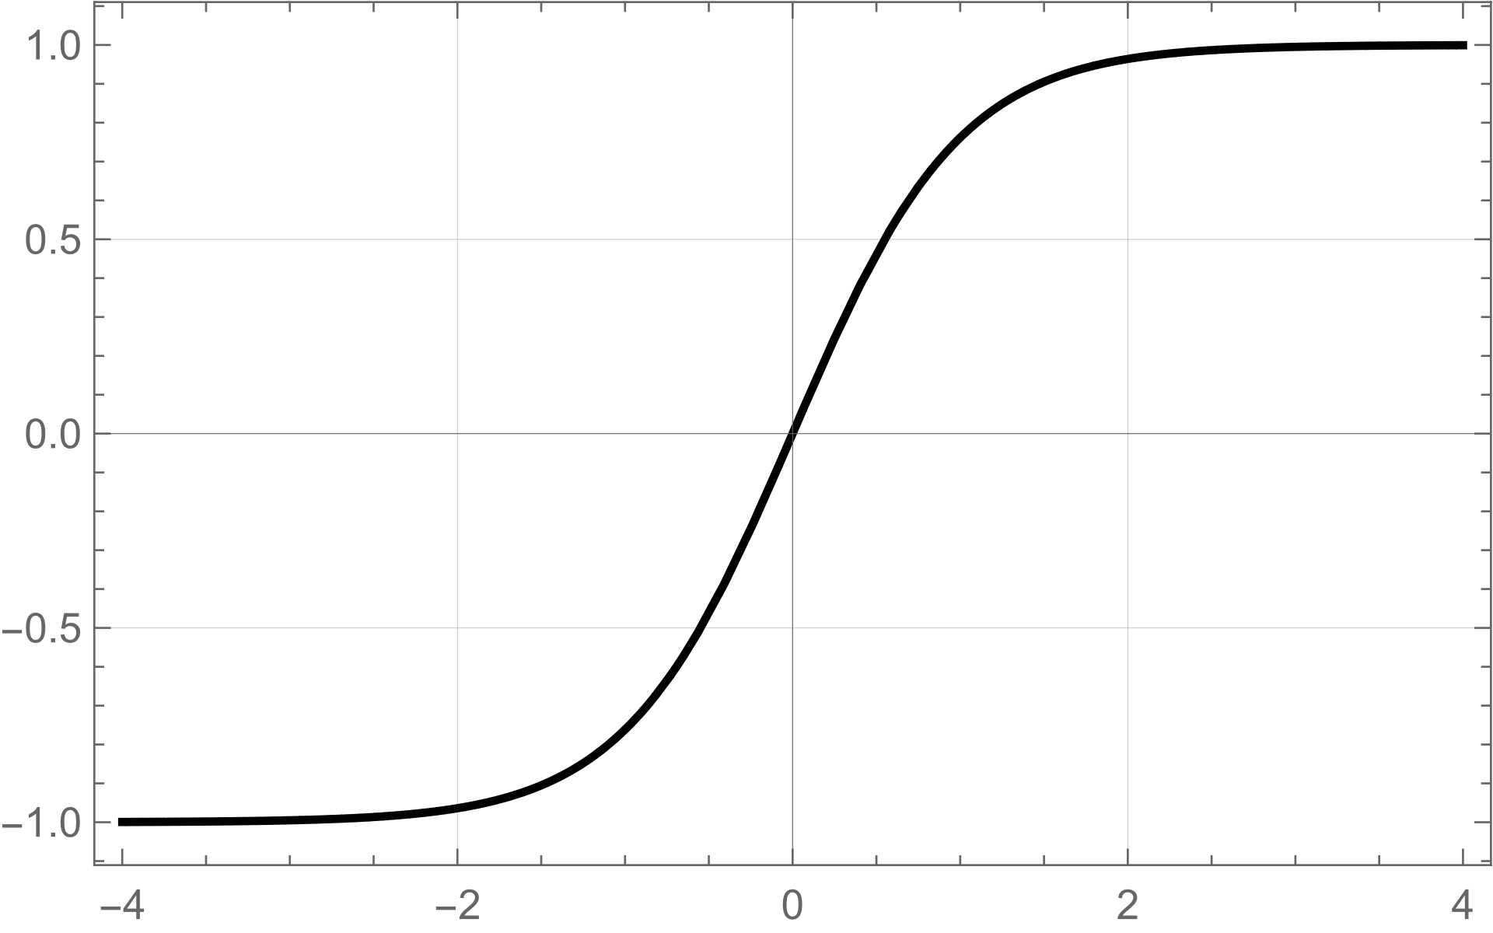
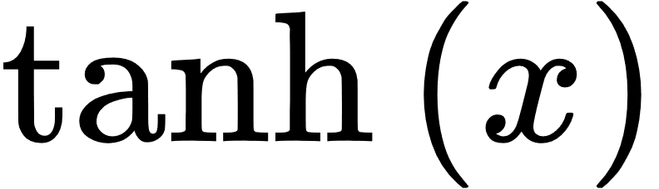
The choice of the activation function
Disadvantages Same as sigmoid function.
Tanh
Zero centered: make it easier to model inputs that have strongly negative, neutral, and strongly positive values. Otherwise like the Sigmoid function.

Slide 16
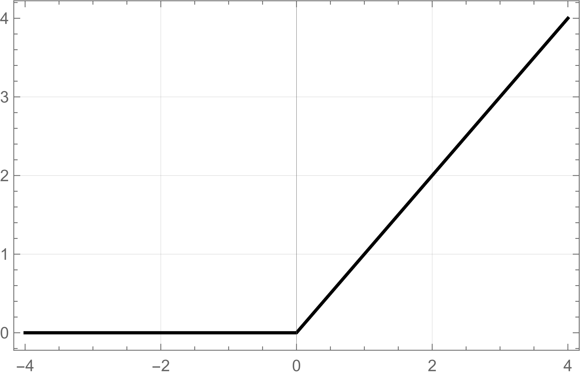
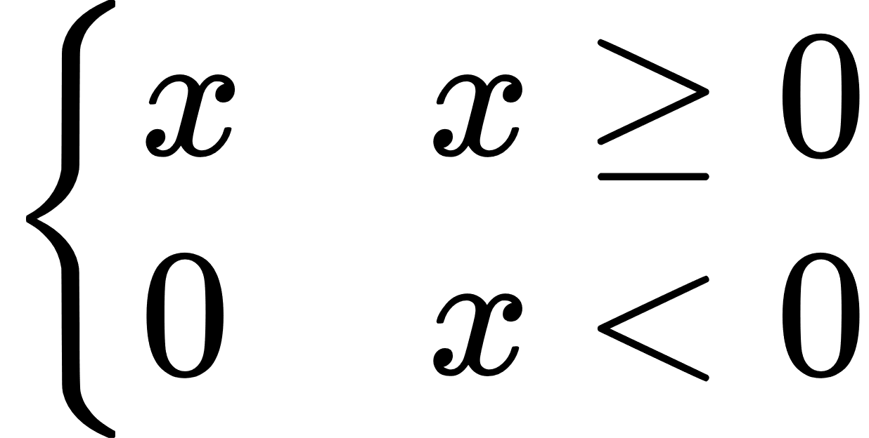
The choice of the activation function
ReLU
Computationally efficient: allows the network to converge very quickly. Used widely in feed-forward networks. It has better performance with respect to other activation functions.
Disadvantages The Dying ReLU problem: when inputs approach zero, or are negative, the gradient of the function becomes zero, the network cannot perform backpropagation and cannot learn.

Slide 17
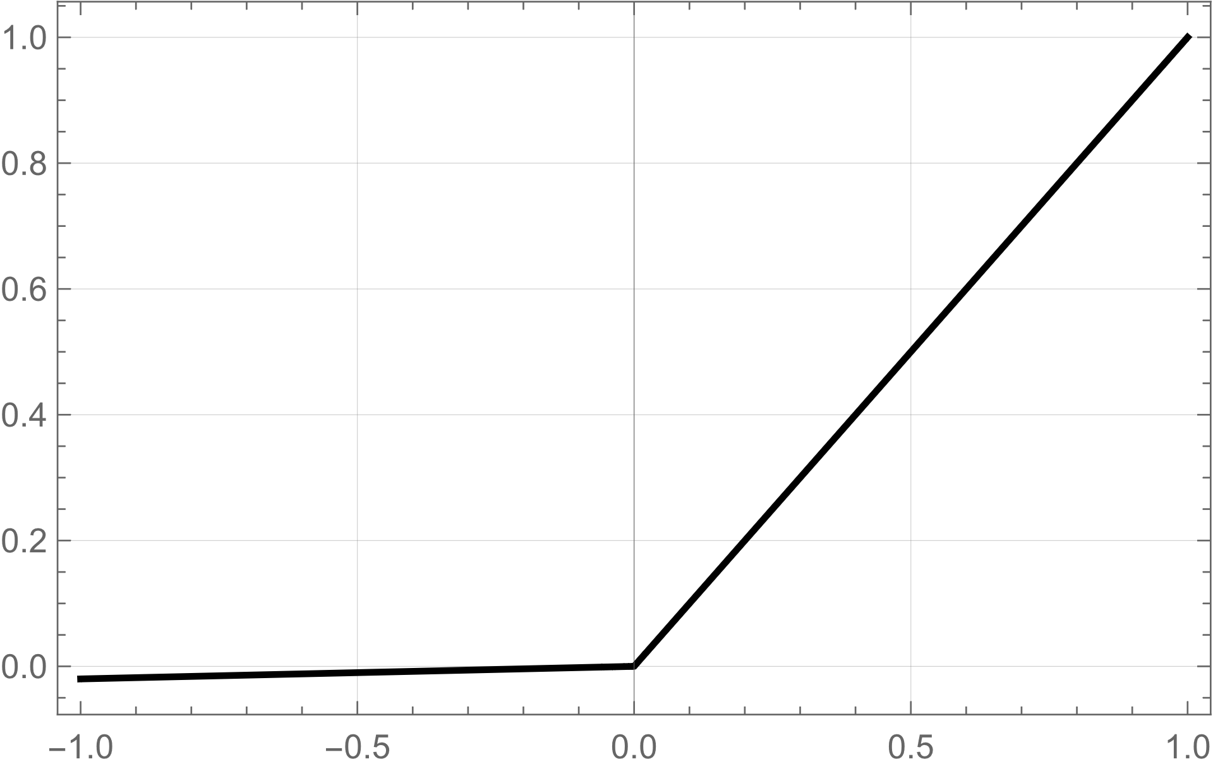

The choice of the activation function
Leaky ReLU
Prevents dying ReLU problem. This variation of ReLU has a small positive slope in the negative area, so it does enable backpropagation, even for negative input values
Disadvantages Results not consistent - leaky ReLU does not provide consistent predictions for negative input values.

Slide 18


The choice of the activation function
Swish or SiLU
Activation function discovered by researchers at Google. According to their paper, it performs better than ReLU with a similar level of computational efficiency. In experiments on image datasets perform ~ 1% better than ReLU. For batch training it seems to be faster than ReLU!
Disadvantages as much as I searched on various paper I found no know disadvantages. ReLU is much known.
Authors claim: “[…] this simple, suboptimal procedure resulted in Swish consistently outperforming ReLU and other activation functions. […] The simplicity of Swish and its similarity to ReLU means that replacing ReLUs in any network is just a simple one line code change.” https://arxiv.org/abs/1710.05941 (2017)

Slide 19


The choice of the activation function
Mish
Very similar to Swish but it is found that it performs slightly better.
Disadvantages same as Swish
https://arxiv.org/abs/1908.08681 (2019!)

Slide 20
Further NN improvements
Dropout is a regularization techniques If well tuned it prevents overfitting, increasing performances. The network could need more epochs to be trained properly but it will be more able to generalize!

Slide 21
Today’s challenges
Black box problem – AI explainability (for example SHAP, based on Shapley values – game theory)
Time consuming – ANN training requires a lot of time and computing power. Also real developement is a challenge.
Amount of data needed – to train an ANN require a huge amount of data and often (not always) simple algorithms give comparable results with smaller datasets. Moreover large number of data lead also to problems such as overfitting.

